Slide 1

MINI PROJECT PRESENTATION CONTENT MASTER
Submitted to :-
Mr. Ashish Kumar
Submitted By:-
Tanmay Teotia
Shubham Anand
Saurabh Kumar Yadav
Shivansh Maurya
GROUP NUMBER -39
Department of Computer Science & Engineering
IMS Engineering College, Ghaziabad, U.P, India

Slide 2
CONTENT
INTRODUCTION
DESCRIPTION ABOUT THE PROJECT
METHODOLOGY
IMPLEMENTATION
RESULTS
CONCLUSION

Slide 3
INTRODUCTION:-
WEB DEVELOPMENT
Web development refers to the creating, building, and maintaining of websites.
It includes aspects such as web design, web publishing, web programming, and database management.
Web Development can be classified into two ways:
Frontend Development
Backend Development

Slide 4





BRIEF DESCRIPTION ABOUT MINI PROJECT
Content Master Project is a website based on Web development .
The motive of our project is to provide a quality material for the technical courses students and faculty as well.
We are inspired from W3school, GeeksforGeeks.
We are adding Notes for every subject and year wise as well as Video Tutorials, Ebooks, Assignments and Programming Quizzes.
We will also provide Premium E-books like Introduction to Algorithms, Big Data etc. Which is not easily available over the internet for free of cost.

Slide 5
METHODOLOGY & IMPLEMENTATION:-
We uses HTML for web page formatting.
CSS for Designing and making attractive UI.
We are still working for better Data Management part of our Website.
Sources of our Data Will be :-
Forcoder.su
BooksFlix
YouTube and Udemy for Video tutorials.
And some sources of our website is ‘Confidential’.

Slide 6
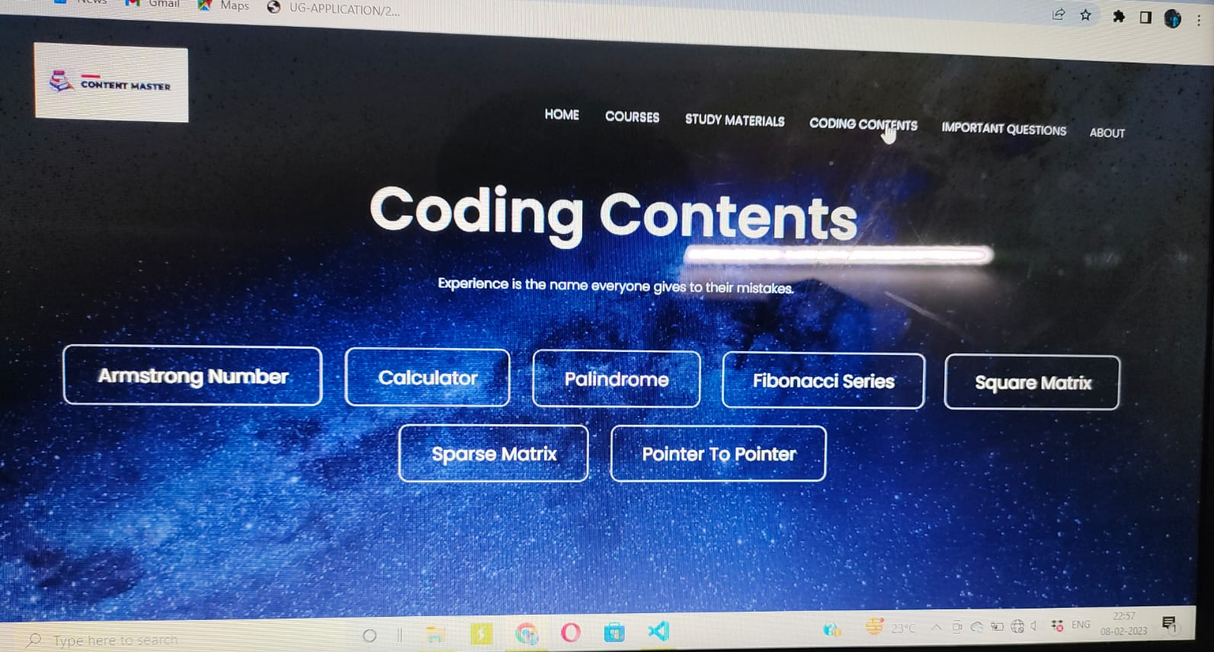
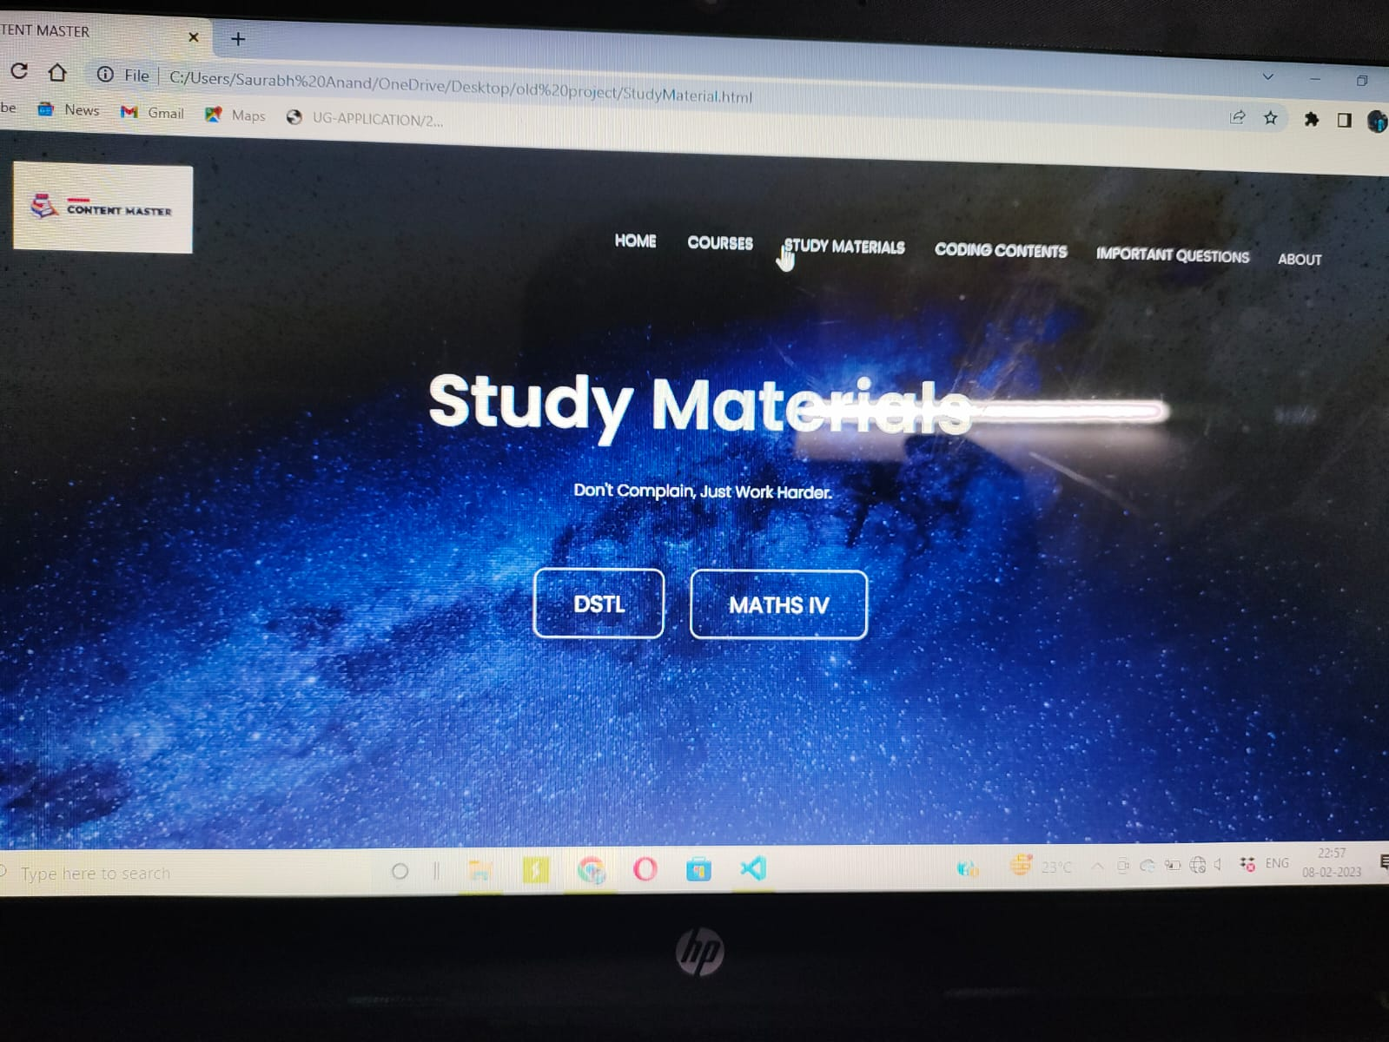
ReSULT:-

Slide 7
CONCLUSION:-
Our web is available 24*7 and free of charges.
We are Planning to Collaborate with institutions for adding courses regarding Coding and Placement Guidance.
We are improving our UI for future to make it easy to use and ads , distraction free.

Slide 8
THANK YOU EVERYONE

